Slide 1
Chicago Crime Data Analysis
Capstone Project – 3
By
Gowri

Slide 2
Introduction
This presentation provides insights into Chicago's crime data.
Crime Count
Geographic distribution of crimes
Time-based crime trends
Arrest insights
Interactive filters for analysis
Seasonal crime analysis

Slide 3
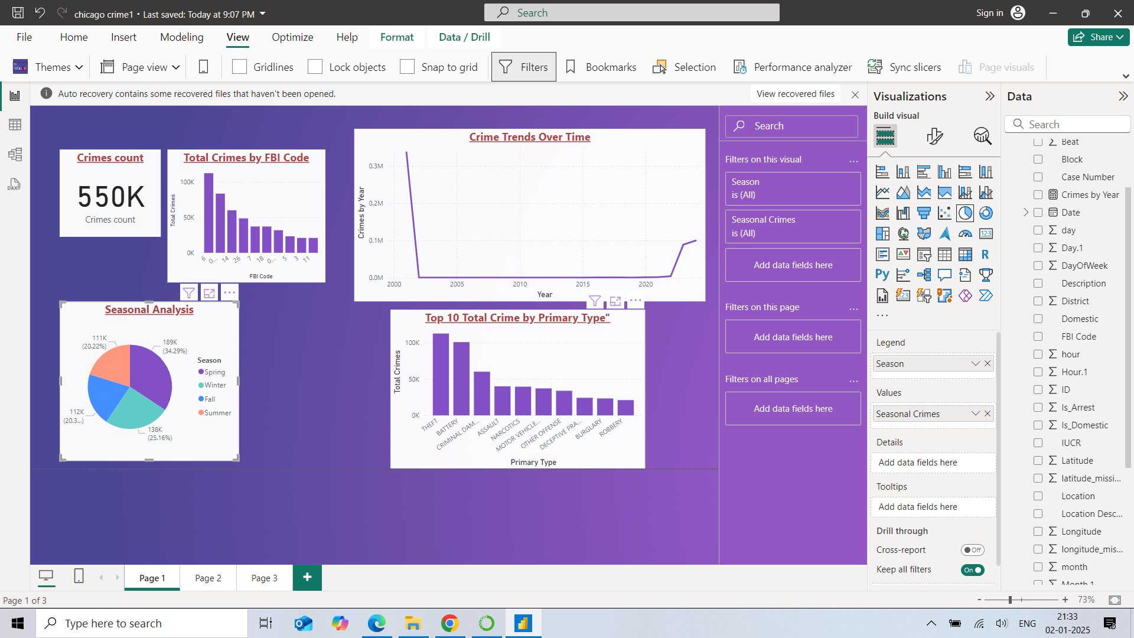
Crime Count
550,000 crimes cover a range of offenses, including theft, assault, narcotics, and more.
This data provides insights into crime trends, helping law enforcement agencies focus efforts where needed.
By understanding the total count, we can identify areas for improvement and enhance safety measures across the city.

Slide 4
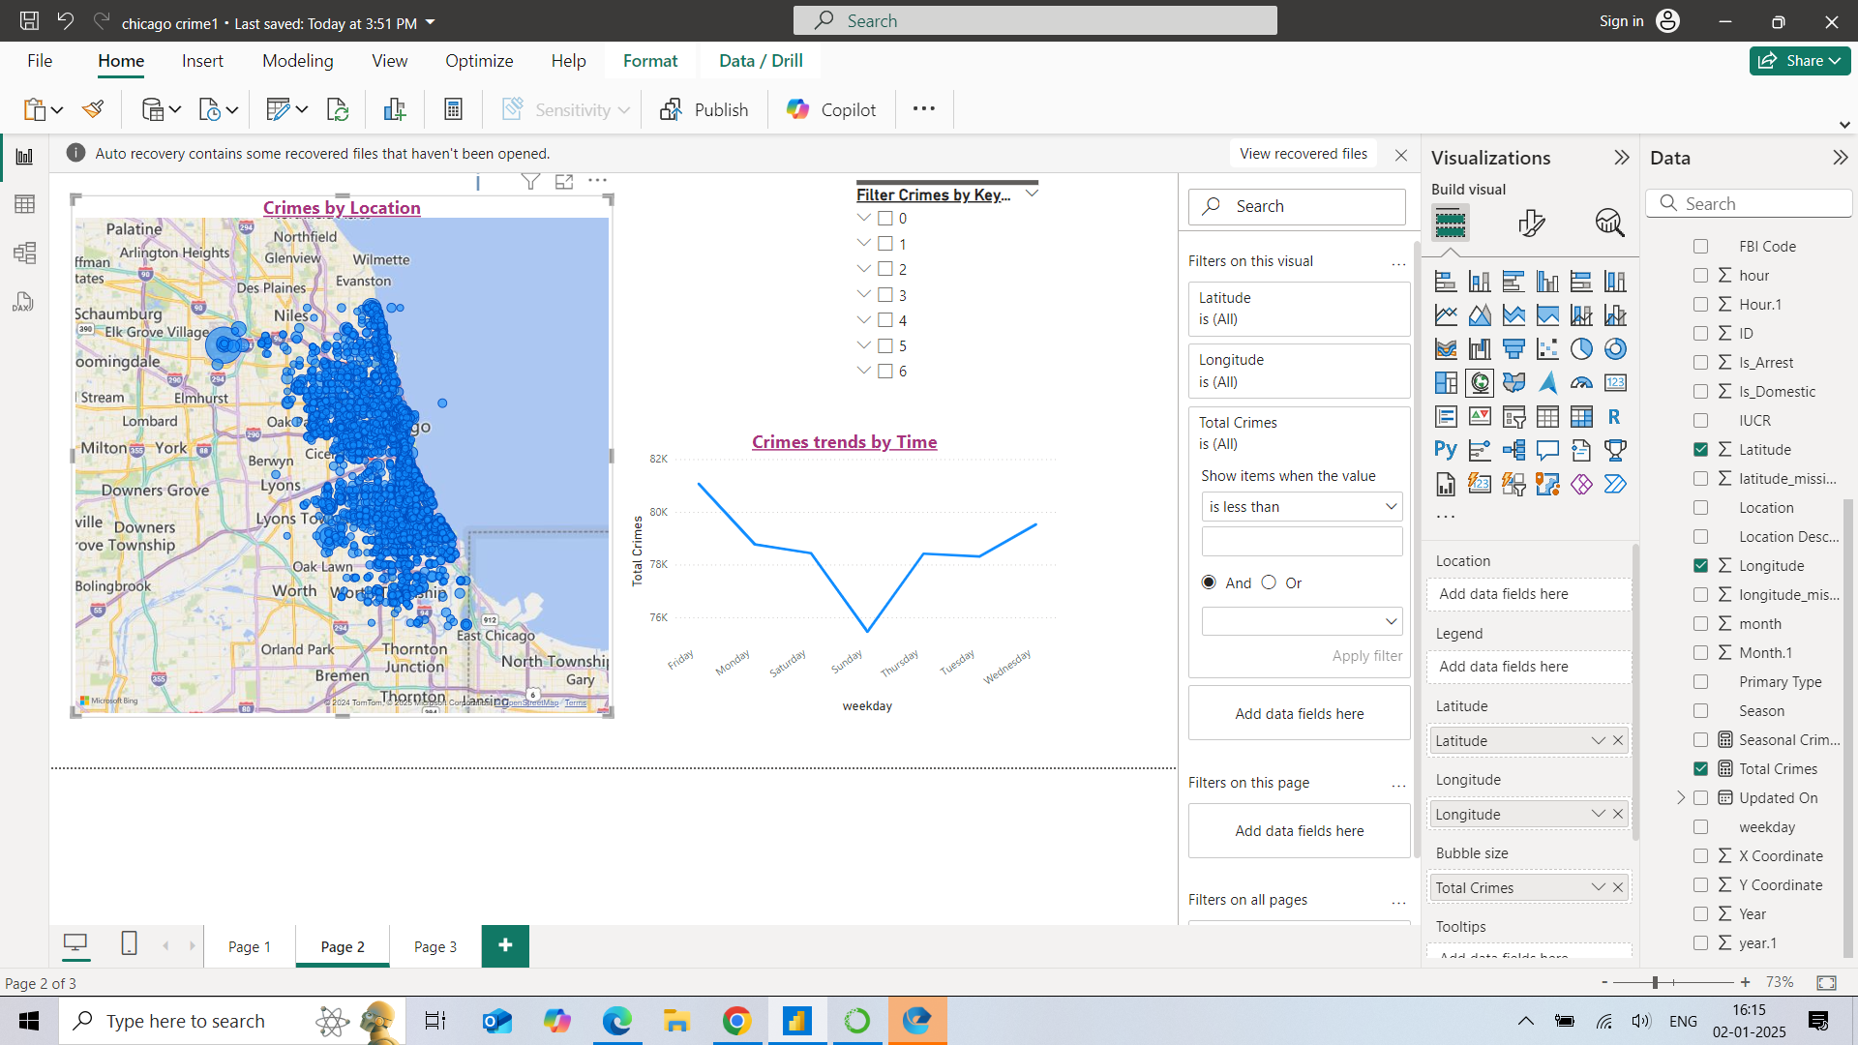
Geographic Distribution of Crimes
This map shows where most crimes happen in Chicago.
- Larger bubbles mean more crimes in that area.
- Helps identify crime hotspots.

Slide 5
Crime Trends by Days
This chart shows crime trends across different days.
- Certain days have higher crime rates.
- Helps in scheduling patrols effectively.

Slide 6
Dynamic Filters for Crime Data
Filters make it easy to focus on specific data:
- By District
- By Day of the Week
- By Domestic or Non-Domestic Crimes
This makes analysis more interactive and insightful.

Slide 7
Seasonal crime analysis
This pie chart shows the distribution of crimes in Chicago across the four seasons:
Spring - Highest crime rate, possibly due to more outdoor activity as the weather warms up.
Winter - Moderate crime rate, likely influenced by harsh weather conditions
Fall - Slightly lower crime rate, as temperatures begin to cool.
Summer - The lowest crime rate, which could be related to increased police presence or summer safety programs.

Slide 9
Conclusion
Key Findings:
Geographic and time-based crime patterns identified.
Arrest trends analyzed.
Interactive tools enhance data exploration.
Recommendations:
Increased patrol in high-crime areas.
Focus on peak crime hours.

Slide 10
Thank you!!!

